Slide 1
Managing Information Technology Resources ITWS 4310
Facebook Case
November 15, 2018

Slide 2
Managing IT Resources Class Outline: Thurs, Nov 15, 2018
MITR Term Project
Schedule Meetings with Client and Invite Faculty to Meetings
Finish the Entire Project
Draft of Entire Term Project Final Report on Nov 19 by 9 PM
Final Presentations on Dec 6 and Dec 10
All Teams Submit Final Reports on Dec 10
All Students Grade and Rank all Presentations by Dec 11
All Students Complete Peer Evaluations of Their Team by Dec 11
Current Events
Chapter 10: The Sharing Economy, Collaborative Consumption, and Efficient Markets through Tech
Facebook Case

Slide 3
Randomly Assigned Final Presentation Schedule
Thursday Dec 6
Team 5
Team 2
Team 4
Monday Dec 10
Team 3
Team 1
Team 6
Invite your Clients to attend your class presentation and any or all of the other presentations on the two days.
In Addition, offer to present in a longer format (~ 1 hour) at the Client’s Location or on a Video Link to the Client’s Location.
If your Client cannot attend the day scheduled, but could on the other day, let us know and we will try to accommodate.
Presentations will be 15 minutes long with 5 minutes for Q&A. Time will be monitored and you will be given visual warnings at 3, 2, 1 minutes respectively.

Slide 4
Managing IT Resources ITWS 4310-01 Term Project Final Presentations
10-15 minutes for presentation and demo
5 minutes for Q&A
All team members present and participating
Business Attire
Invite Clients to Presentation
All students grade and rank other presentations

Slide 5
Suggestions for Oral Presentations
Be prepared: know the material well
Be prepared: practice with other team members and before a live audience
Introduce self and team
One person in front of audience at one time – others “off stage” to side
Tell audience what you are going to cover verbally or in an agenda
Display energy and engagement
Display good posture
Speak clearly and loudly enough so that you can be heard throughout the room
Move your head and body to speak to all parts of the room
Make direct eye contact with audience members in various parts of the room
Use gestures to emphasize points and to point to some particularly important aspects of the visuals. Do not use so many gestures that it is distracting.
Keep your hands out of pockets or other parts of clothing
Use transitions to new presenter – introduce next presenter – next presenter says “Thanks xyz” and start with strong first sentence
Summarize at end of section and end of presentation – strong conclusion
Plan the time to be taken by each presenter. Remember transition times. Practice for timing. Keep within time allotted.
Prepare the slides so that they are visually attractive, communicate key points, have good flow, are “branded” for the particular talk, are of sufficiently large font that they can be read from the back of the room
Practice, practice, practice!

Slide 6
Project | Client, Team, Problem, Solution Concept | CBA, Risk Anal., Project Plan, Schedule | Requirements, Design, Development | Results, Conclusions, Lessons Learned, Challenges | Demon-stration of Solution | Presentation, Slides, Speaking | Total | Rank Order (1=Best) No ties. Do not Rank own Team
Points Possible | 1.0 | 1.0 | 2.0 | 2.0 | 2.0 | 2.0 | 10.0 | (1-5)
Team 5: OTELCO |  |  |  |  |  |  | 0.0
Team 2: AM/PM Design & DemoWorks |  |  |  |  |  |  | 0.0
Team 4: RPI Air Force ROTC |  |  |  |  |  |  | 0.0
Team 3: Cure Dystopia Now |  |  |  |  |  |  | 0.0
Team 1: Troy Cloth & Paper Co. |  |  |  |  |  |  | 0.0
Team 6: Carme.AI |  |  |  |  |  |  | 0.0

Slide 7
Evaluate the Performance of each Team Member on the Term Project (Score from 1-10 with 1 being poor and 10 being excellent)
Team Members | Self | Other Team Member 1 Enter Name Below | Other Team Member 2 Enter Name Below | Other Team Member 3 Enter Name Below
Evaluation Criteria/ Names
Contribute to the ideas for the team project
Attend and actively participate in team meetings
Contribute by being a good team leader
Contribute by being a good listener and team follower
Provide deliverables to team on time as committed
Contribute to the planning and organization of the project
Contribute to the technical aspects of the project
Contribute to the writing and presentation of the project
Contribute fair share of the overall workload to the project
Overall contribution to the team project
Total

Slide 8
Managing IT Resources: ITWS 4310 Term Project Report Outline
Section 1: Executive Summary
Section 2: Introduction
Section 3: Client Organization and Description
Section 4: Project Team
Section 5: Problem Statement
Section 6: IS/IT Solution
Section 7: Methodology
Section 8: IS/IT Requirements
Section 9: IS/IT Design
Section 10: Cost-Benefit Analysis with (Risk Mgmt)
Section 11: Project Plan/Schedule/Resources
Section 12: Post-Turnover Plan
Section 13: Results and Client Feedback
Section 14: Conclusions
All Sections of Final Report in Draft due by Nov 19 (Mon before Thanksgiving) at 9 PM

Slide 9
Managing IT Resources: ITWS 4310 Term Project Report Outline
Section 1: Executive Summary
Should be able to “stand on its own”
Provides an “executive” overview of the entire project
What are the important points that an executive would need to know?
The best summaries effectively balance details with a concise writing style

Slide 10
Managing IT Resources: ITWS 4310 Term Project Report Outline
Section 2: Introduction
Keep it short – 2-3 sentences
Only 2 objectives: provide a little context for the project and pique interest to read on
Section 3: Client Organization and Description
Give some idea of the size of the organization: number of employees, number of locations, etc.
Include Client Contact name and contact information
Section 6: IS/IT Solution
If solution has changed throughout semester, make reference to the original solution concept and then describe current/latest solution concept
Section 7: Methodology
Brief description of how each major aspect of project was done e.g. a cost benefit analysis focused on NPV and IRR was used to assess financial viability of the project. Don’t’ be repetitive with subject section
Cover project/client selection, requirements, development methodology, financial viability, project management, implementation methodology, and client feedback method

Slide 11
Managing IT Resources: ITWS 4310 Term Project Report Outline
Section 8: IS/IT Requirements
Categorize both Functional and Non-Functional Requirements
Section 9: IS/IT Design and Development
Use-Case Summary (part of narrative) and Use-Case Diagram
Work Flow Diagram (logic that connect back-end with front-end)
Back-end Design including Data Work Flow and Database Design
Front-end Design including Mock-ups, Wireframes, Screen Shots
Working System including link to working system or prototype
Access to Code in Code Repository
Test Plan(s) and Test Results
Narrative of All Design and Development
Section 10: Cost Benefit Analysis with Risk Management
Combine the Excel Sheets for CBA and Risk Management into one Excel Workbook
Combine the CBA and Risk Management into one Narrative

Slide 12
Managing IT Resources: ITWS 4310 Term Project Report Outline
Section 11: Project Management/Resource/Schedule
Specify reference to separate Gantter project plan
Include screenshot showing entire project in report
Summary of major project phases including the duration, work effort, costs for each phase. Can be organized into a summary table
Section 12: Post-Turnover Plan
Installation
Training
Documentation
Future support and maintenance plan

Slide 13
Managing IT Resources: ITWS 4310 Term Project Report Outline
Section 13: Results and Client Feedback
Specify what functionality was delivered when
Results showing that the System meets the “Requirements” or not
Client Feedback
Section 14: Conclusions
What were the “lessons learned” by the team
What worked well
What didn’t work well
What would you do differently “next time”
Cover team dynamics, client dynamics, and technology

Slide 14
DO’S - Draft MITR Final Project Report
Submit the draft with all sections completed
Use the “Outline” as provided in the Project Assignment
Write an “Executive Summary” that covers all of the key qualitative and quantitative points from the project in up to 2 pages. Think of it as an entirely separate document.
Write or rewrite all of the sections as of the end of the Project (current situation, verb tenses)
Write in the “Third Person” throughout the Report; i.e. “The Team”, “The Client”, not “I”, “We”, “Our”.
Integrate the whole report as a single narrative (make it flow, consistent style, don’t repeat, don’t leave out material)
Proofread for grammar, spelling, consistent style and formatting
Include Gantter Project Plan. Include text in the report to explain.
Include CBA sheet and Risk Management sheet in single Excel Workbook Include text in the report to explain.

Slide 15
DON’TS - Draft Final Project Report
Simply paste together the milestone assignments.
They were written at different times and the verb tenses are not correct for the Final Report.
They were written at different times and they may not flow and integrate well as a single narrative.
They were written for various purposes that may not be appropriate for the Final Report, e.g., team description may be too detailed on your team member’s backgrounds.
Leave out the “Results and Conclusions” since you are not be finished. Include the results and conclusions written as if the project has been completed. It’s ok at this point to infer. You will adjust this accordingly for the final report.

Slide 16
Technology Current Events: “Amazon selects New York City and Northern Virginia for new headquarters”, The Amazon Blog, November 13, 2018. https://blog.aboutamazon.com/company-news/amazon-selects-new-york-city-and-northern-virginia-for-new-headquarters
Amazon today announced that we have selected New York City and Arlington, Virginia, as the locations for our new headquarters. Amazon will invest $5 billion and create more than 50,000 jobs across the two new headquarters locations, with more than 25,000 employees each in New York City and Arlington. The new locations will join Seattle as the company’s three headquarters in North America. In addition, Amazon announced that it has selected Nashville for a new Center of Excellence for its Operations business, which is responsible for the company’s customer fulfillment, transportation, supply chain, and other similar activities. The Operations Center of Excellence in Nashville will create more than 5,000 jobs.
The new Washington, D.C. metro headquarters in Arlington will be located in National Landing, and the New York City headquarters will be located in the Long Island City neighborhood in Queens. Amazon’s investments in each new headquarters will spur the creation of tens of thousands of additional jobs in the surrounding communities. Hiring at both the new headquarters will begin in 2019. The Operations Center of Excellence will be located in downtown Nashville as part of a new development site just north of the Gulch, and hiring will also begin in 2019.
“We are excited to build new headquarters in New York City and Northern Virginia,” said Jeff Bezos, founder and CEO of Amazon. “These two locations will allow us to attract world-class talent that will help us to continue inventing for customers for years to come. The team did a great job selecting these sites, and we look forward to becoming an even bigger part of these communities.”

Slide 17
Technology Current Events: “AMC Is Running Into the Same Problems as MoviePass”, The Motley Fool, November 13, 2018. https://www.fool.com/investing/2018/11/13/amc-is-running-into-the-same-problems-as-moviepass.aspx
AMC Entertainment Holdings is raising the price of Stubs A-List, its ticket subscription service, by up to $4 a month in the 15 states where it is most popular. It's an indication the theater operator has discovered, just like MoviePass before it, that the more moviegoers use the service the less sustainable the concept is.
AMC says it won't whipsaw subscribers the way its rival did by changing the terms and benefits seemingly every few days, but AMC's decision to increase A-List's price suggests that, although moviegoers like these deals and they're having an impact on the way tickets are sold, they may not be best for the long-term health of the provider.
AMC's Stubs A-List program has some built-in safeguards to help keep it from running off the rails the way MoviePass's plan did. It limits movie fans to just three movies a week for $20 per month at any of its theaters. MoviePass originally allowed subscribers to see an unlimited number of movies for only $10 per month, an obvious disaster in the making that now has its owner Helios and Matheson Analytics looking to spin off the service.
While AMC's program looks more sustainable, even it will turn into a money-losing proposition if people use it too much, since after just two movies a month it becomes a financial drain. Even Sinemia, a service with a number of plans ranging from one to three movies per month at different price points, causes them to lose money if members use the plan as permitted.
It appears that all such subscription services have a similar fatal flaw: they are counting on you to not use your service to the fullest. They're playing the law of averages, depending on what Sinemia calls the "modern moviegoer," who sees on average three movies a month. While the Motion Picture Association of America says most moviegoers see four to six movies a year, in either case the subscriptions should break even at worst, or even become profitable if subscribers follow the averages.

Slide 18
Technology Current Events: “Waymo to Start First Driverless Car Service Next Month”, Bloomberg, November 13, 2018. https://www.bloomberg.com/news/articles/2018-11-13/waymo-to-start-first-driverless-car-service-next-month
In just a few weeks, humanity may take its first paid ride into the age of driverless cars.
Waymo, the secretive subsidiary of Google’s parent company, Alphabet Inc., is planning to launch the world’s first commercial driverless car service in early December, according to a person familiar with the plans. It will operate under a new brand and compete directly with Uber and Lyft.
Waymo is keeping the new name a closely guarded secret until the formal announcement, said the person, who asked not to be identified because the plans haven’t been made public.
It’s a big milestone for self-driving cars, but it won’t exactly be a “flip-the-switch” moment. Waymo isn’t planning a splashy media event, and the service won’t be appearing in an app store anytime soon, according to the person familiar with the program. Instead, things will start small—perhaps dozens or hundreds of authorized riders in the suburbs around Phoenix, covering about 100 square miles. The first wave of customers will likely draw from Waymo’s Early Rider Program—a test group of 400 volunteer families who have been riding Waymos for more than a year. The customers who move to the new service will be released from their non-disclosure agreements, which means they’ll be free to talk about it, snap selfies, and take friends or even members of the media along for rides. New customers in the Phoenix area will be gradually phased in as Waymo adds more vehicles to its fleet to ensure a balance of supply and demand.
The launch of a commercial ride-hailing service will mark an end to the intense secrecy that’s surrounded Waymo’s program—and self-driving research in general—since Google first started working on it a decade ago. “This positions Waymo really far ahead of everyone else,” said Nick Albanese, an intelligent mobility analyst at Bloomberg New Energy Finance. “GM is the other leader, and they’re probably more than a year away from doing this. It’s very impressive.”

Slide 19
Technology Current Events: “Facebook's site was down for 30 minutes, here's why”, Bloomberg, November 12, 2018. https://www.foxbusiness.com/technology/facebooks-site-is-down-company-says-its-working-on-it
Facebook’s site was down for about 30 minutes on Monday due to an error in a routine test, the company confirmed to FOX Business.
From 12:54 p.m. to around 1:30 p.m. ET a message popped up saying, “Sorry, something went wrong. We’re working on it and we’ll get it fixed as soon as we can.” The problem was quickly fixed and the site was restored at around 1:30 p.m. ET.
A spokesperson tells FOX Business a routine test caused users to have trouble accessing or posting to all Facebook services including WhatsApp and Instagram but they “quickly investigated and restored access for everyone.”
“We’re sorry for the inconvenience,” the company added.

Slide 20
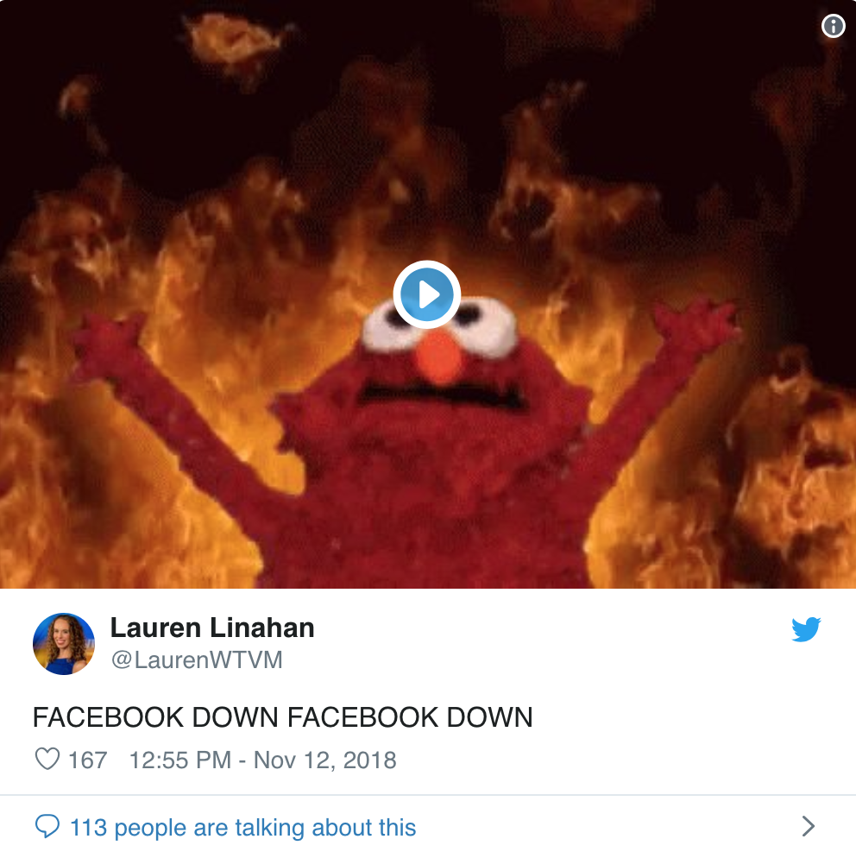
Technology Current Events: “Facebook's site was down for 30 minutes, here's why”, Bloomberg, November 12, 2018. https://www.foxbusiness.com/technology/facebooks-site-is-down-company-says-its-working-on-it
Facebook’s site was down for about 30 minutes on Monday due to an error in a routine test, the company confirmed to FOX Business.
From 12:54 p.m. to around 1:30 p.m. ET a message popped up saying, “Sorry, something went wrong. We’re working on it and we’ll get it fixed as soon as we can.” The problem was quickly fixed and the site was restored at around 1:30 p.m. ET.
A spokesperson tells FOX Business a routine test caused users to have trouble accessing or posting to all Facebook services including WhatsApp and Instagram but they “quickly investigated and restored access for everyone.”
“We’re sorry for the inconvenience,” the company added.

Slide 21
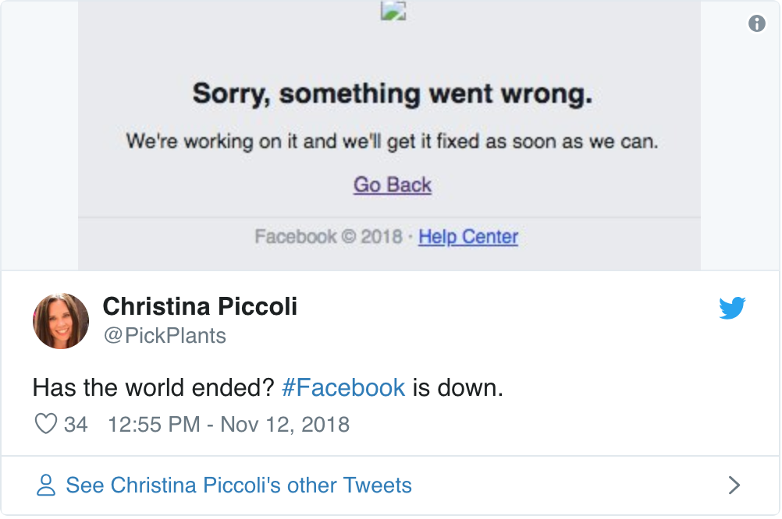
Technology Current Events: “Facebook's site was down for 30 minutes, here's why”, Bloomberg, November 12, 2018. https://www.foxbusiness.com/technology/facebooks-site-is-down-company-says-its-working-on-it
Facebook’s site was down for about 30 minutes on Monday due to an error in a routine test, the company confirmed to FOX Business.
From 12:54 p.m. to around 1:30 p.m. ET a message popped up saying, “Sorry, something went wrong. We’re working on it and we’ll get it fixed as soon as we can.” The problem was quickly fixed and the site was restored at around 1:30 p.m. ET.
A spokesperson tells FOX Business a routine test caused users to have trouble accessing or posting to all Facebook services including WhatsApp and Instagram but they “quickly investigated and restored access for everyone.”
“We’re sorry for the inconvenience,” the company added.

Slide 22
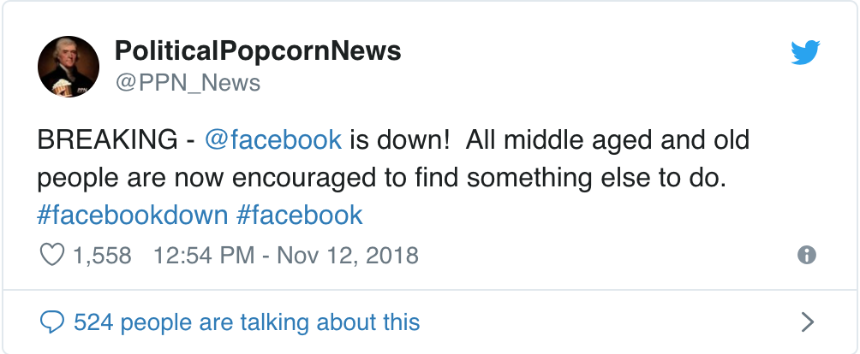
Technology Current Events: “Facebook's site was down for 30 minutes, here's why”, Bloomberg, November 12, 2018. https://www.foxbusiness.com/technology/facebooks-site-is-down-company-says-its-working-on-it
Facebook’s site was down for about 30 minutes on Monday due to an error in a routine test, the company confirmed to FOX Business.
From 12:54 p.m. to around 1:30 p.m. ET a message popped up saying, “Sorry, something went wrong. We’re working on it and we’ll get it fixed as soon as we can.” The problem was quickly fixed and the site was restored at around 1:30 p.m. ET.
A spokesperson tells FOX Business a routine test caused users to have trouble accessing or posting to all Facebook services including WhatsApp and Instagram but they “quickly investigated and restored access for everyone.”
“We’re sorry for the inconvenience,” the company added.

Slide 23
Chapter 10
The sharing economy, collaborative consumption, and efficient markets through tech

Slide 24
What is the Sharing Economy?

Slide 25
The Sharing Economy
Technology allows product and service providers to connect with consumers.
Offers far greater reach and efficiency than traditional markets.
Generation of ‘citizen suppliers.’
Product owners become providers of rentals.
New class of micro-entrepreneurs providing personal services.

Slide 26
What is Collaborative Consumption?

Slide 27
What is Collaborative Consumption?
Categories of products are collaboratively consumed.
An individual takes possession of an item for a period of time and then returns it for use by others.
Internet-enabled market makers.
Roots in eBay and CraigsList.

Slide 28
Collaborative Consumption
Examples of firms:
eBay, CraigsList
Zilok, RentTheRunway, Chegg
Etsy, CustomMade
oDesk, eLance, Crowdspring
Angie’s List, TaskRabbit
Drizly
Uber, Lyft, ZipCar
LiquidSpace, ShareDesk
HomeAway
LendingClub, KickStarter, GoFundMe

Slide 29
“Facebook Case”
What is the history of Facebook?

Slide 30
“Facebook Case”
What is the history of Facebook?
Social networking site launched in 2004
Founded by Mark Zuckerberg at Harvard
Summer 2004 Peter Thiel made $500,000 Angel Investment for 10% of company
Expanded to 21 Universities in 2005
Sheryl Sandberg hired as COO in 2008
As of 2010, Facebook's social graph is the largest social network dataset in the world
IPO Feb 2012 with 845 m active users
Instagram acquired in 2012 for $1B
WhatsApp acquired in 2014 for $19B
Oculus acquired in 2014 for $2B
2017 – FB apps account for 30% of US mobile traffic

Slide 31
“Facebook Case”
In what businesses does Facebook compete?

Slide 32
“Facebook Case”
In what businesses does Facebook compete?
Social Networking
Advertising
Photo Sharing
Cross Platform Messaging and VoIP
Business Marketing
Virtual Reality Hardware
3rd Party Retail Marketplace

Slide 33
“Facebook Case”
Who are Facebook’s competitors?

Slide 34
“Facebook Case”
Who are Facebook’s competitors?
Google
Amazon
LinkedIn
Twitter
Skype - Microsoft
Tencent QQ
Renren
Tumblr
Sina

Slide 35
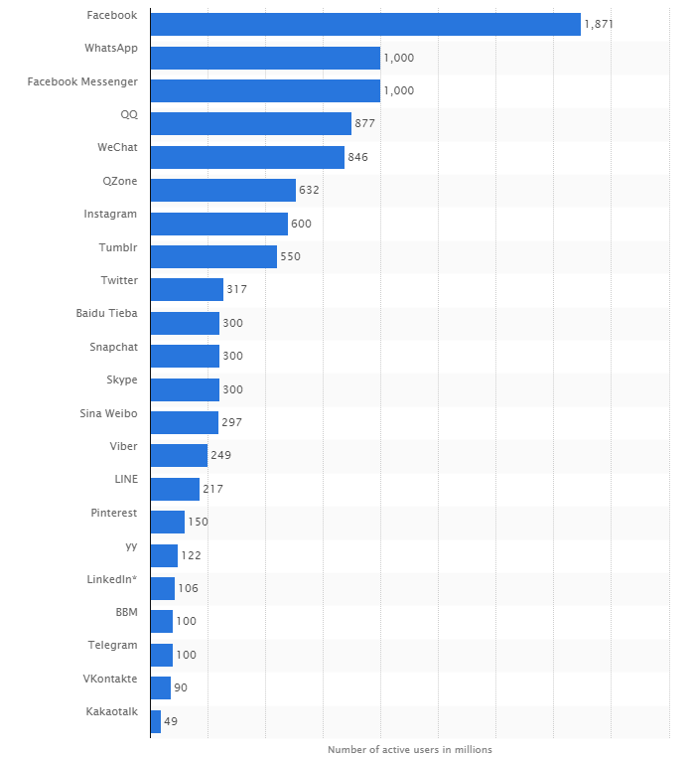
MOST USED SOCIAL APPS. World Economic Forum.
https://assets.weforum.org/editor/MWRs37B_A5a5INGyQwxmijU74_iHeD_EUYSf676cQ88.PNG

Slide 36
“Facebook Case”
What are major Facebook “Competitive Advantages”?

Slide 37
“Facebook Case”
What are major Facebook “Competitive Advantages”?
Largest Social Network User Base contributing Content
Largest Social Graph – Profiles of 2 Billion Persons
Metcalfe’s Law – Largest Value due to Largest Number of Users
Network Effects – Economies of Scale – Low Cost per User
Switching Costs
Moore’s Law makes possible storage, sharing and analyzing of trillions of artifacts of billions of persons
Gilder’s Law makes possible access to trillions of photos, videos, other file types, live streaming content from/to anyplace in the world
Global Reach
Brand
Large amount of Cash to acquire novel Services/Products
Trust that Privacy will be honored
Large “Dark Web” inside of Facebook not searchable by Competitors
Feeds catalyze “Virality”
Innovation

Slide 38
“Facebook Case”
How is Facebook using “Data and Analytics”, “Machine Learning” and “Artificial Intelligence” to gain “Competitive Advantage”?

Slide 39
“Facebook Case”
How is Facebook using “Data and Analytics”, “Machine Learning” and “Artificial Intelligence” to gain “Competitive Advantage”?
Create, Analyze, and Leverage Largest Social Graph
Analytics to “Recommend” Products and Services
Algorithms to “Serve Ads” to Maximize Clicks and Revenues
Algorithms to Show Posts to Maximize User Time and Attention

Slide 40
“Facebook Case”
How is Facebook using the “Social Graph” to create and maintain “Competitive Advantage”?

Slide 41
“Facebook Case”
How is Facebook using the “Social Graph” to create and maintain “Competitive Advantage”?
Relationships between/among individuals
Relationships between/among interests
Relationships between/among photos/videos/audio
Relationships between/among locations
Relationships between/among “things” (IoT)
Relationships between/among “Relationships”

Slide 42
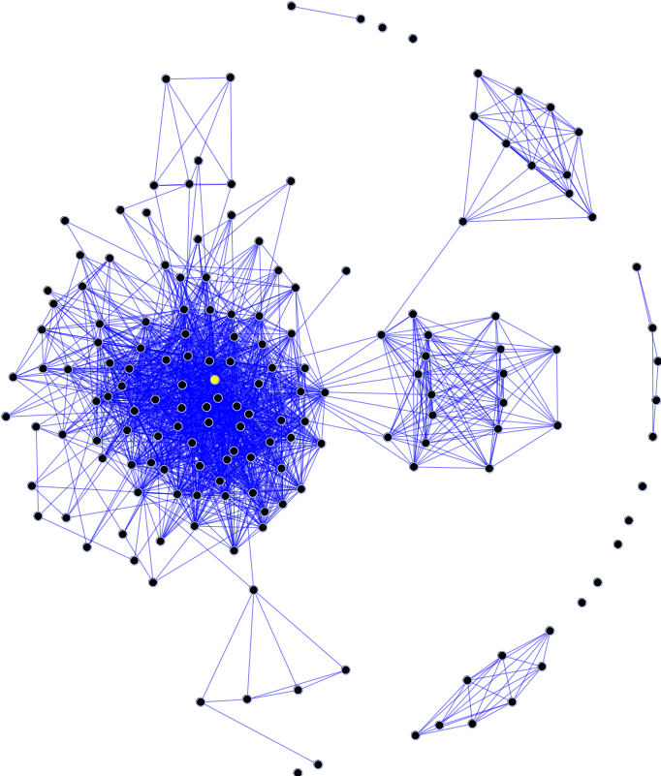
“Facebook Case”
How is Facebook using the “Social Graph” to create and maintain “Competitive Advantage”?
The social graph in the Internet context is a graph that depicts personal relations of internet users. In short, it is a model or representation of a social network, where the word graph has been taken from graph theory. The social graph has been referred to as "the global mapping of everybody and how they're related".^{[1]}
https://en.wikipedia.org/wiki/Social_graph
Open Graph[edit]
Further information: Facebook Platform § Open Graph protocol
Facebook's Graph API allows websites to draw information about more objects than simply people, including photos, events, and pages, and their relationships between each other. This expands the social graph concept to more than just relationships between individuals and instead applies it to virtual non-human objects between individuals, as well.^{[11]}

Slide 43
“Facebook Case”
What are the advantages and disadvantages for Facebook of being a “Platform”?

Slide 44
“Facebook Case”
What are the advantages and disadvantages for Facebook of being a “Platform”?
Advantages
Many Apps attract many users
Many 3rd Party Developers (400,000 developers create 24,000 applications)
Can communicate, share, access friends info all within Platform
Facebook takes 30% of Apps Virtual Goods
Disadvantages
Users spend attention in App
Small screen size on Smartphones favor single purposed specialized apps
Privacy concern
Security concern
Revenue Sharing - Free-Rider concern
Mis-behaving partner can create financial loss, damage brand, sow distrust

Slide 45
“Facebook Case”
How do the Market Capitalization (recent value), Revenue (most recent year), Revenue Growth Rates (5 yr. growth rate), Gross Profit Margins (5 yr. avg.), Net Profit Margins (5 yr. avg.) and Stock Price Comparison for the Last 5 Years compare for Facebook, Alphabet/Google, Microsoft, Tencent Holdings (parent of QQ), and Amazon? See Financial Results at www.reuters.com/finance and previous cases in this course.

Slide 46
Facebook, Alphabet, Microsoft, Tencent, Amazon, Apple Financials
Financial Metric | Facebook | Alphabet/Google | Microsoft | Tencent Holdings | Amazon
Market Capitalization (Now) | $414 B | $729 B | $805 B | $353 B | $781 B
Revenue (2017) | $40 B | $110 B | $110 B | $237 B | $177 B
Revenue Growth Rate (5 yr avg) | 49% | 19% | 4% | 40% | 23%
Gross Profit Margin (5 yr avg) | 83% | 62% | 66% | 58% | 31%
Net Profit Margin (5 yr avg) | 26% | 22% | 22% | 28% | 0.7%
Stock Price Change (last 5 years) | ~211% | ~103% | ~179% | ~230% | ~329%

Slide 47
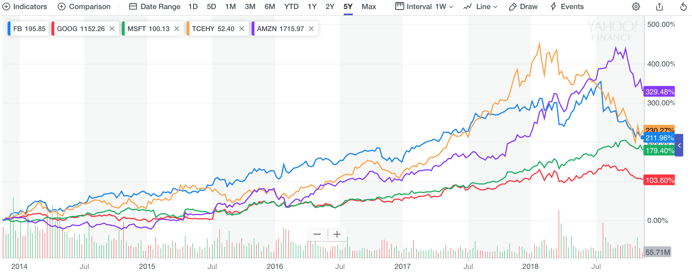
Facebook, Alphabet, Microsoft, Tencent, Amazon Stock Price Change Last 5 Years

Slide 48
“Facebook Case”
Facebook is competing with many of the largest and most successful companies in the world. Facebook must deal with differing regulatory environments in most of the countries of the world. Facebook must contend with changing social perceptions of privacy, security, and brand. Facebook has a little over 2 billion monthly users out of the world’s population of just under 8 billion persons. Describe three separate major challenges that must be overcome to increase their monthly users to 4 billion persons.

